Slide 1

My Biography
?

Slide 2
Name:
Mark Mallari
Age:25
Sex:Male

Slide 3
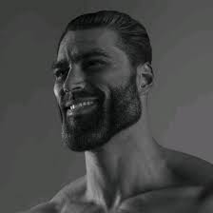
Hobbies:
Playing RPG
Favorite Game of All Time
Ragnarok Online
Favorite Meme:

